Slide 1

Sentiment Analysis On Grocery reviews
By,
Husam Alfergani
Fahad Rabbani
Samain Sabrin
23 April,2018
Supervised by,
Dr. Anthony Breitzman

Slide 2
Table of content
Sentiment analysis
- Definition, importance, challenges
Objectives
Intro to dataset
Steps for analysis
Different statistical models
Data preparation and workflow
Results
Wordcloud on positive and negative sentiments
References & acknowledgement
Page 1

Slide 3
What is Sentiment Analysis
Sentiment analysis and opinion mining is the field of study that analyzes people's opinions, sentiments, evaluations, attitudes, and emotions from written language. ( Liu, B 2012)
Importance
Helps to see what customers like and dislike about a certain product.
Sentiment analysis can let you know if there has been a change in public opinion toward any aspect of your business.
To be more proactive regarding the changing dynamic in the market place through regular sentiment analysis.
Shifts in sentiment on reviews have been shown to correlate with shifts in the stock market.
Challenges
Complexity of human language
Teaching a machine to analyze the various grammatical nuances, cultural variations, slang and misspellings that occur in online mentions is a difficult process.
Contextual understanding is even more difficult process.
“My flight’s been delayed. Brilliant!”
Hard to teach a machine- What is sarcasm
Page 2

Slide 4

Objective of this project
Study Amazon grocery reviews from customers
Finding best prediction model
Predicting whether a review is positive or negative
Page 3

Slide 5
Intro to Dataset
Column Name | Description | Data type
Id | Row Id | Numeric
ProductId | Unique identifier for the product | String
UserId | Unique identifier for the user | String
ProfileName |  | String
HelpfulnessNumerator | Number of users who found the review helpful | Numeric
HelpfulnessDenominator | Number of users who indicated whether they found the review helpful | Numeric
Score | Rating between 1 and 5 | Numeric
Time | Timestamp for the review | Numeric
Summary | Brief summary of the review | String
Text | Text of the review | String
Page 4

Slide 6
Primary Steps in Analysis
Trying different statistical models
Word-cloud for positive and negative sentiments
Data Preparation
Score prediction using best one
Page 5

Slide 7
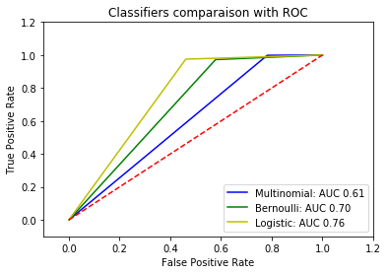
Trying different statistical models
Data Preparation
Word-cloud for positive and negative sentiment
Score prediction using best one
Multinomial Naïve Bayes learning method
Bernoulli Naïve Bayes learning method
Logistic regression learning method
After plotting the ROC curve, it appears that the Logistic regression method provides us with the best results
*Receiver Operating Characteristic (ROC)
Page 6

Slide 8
Trying different statistical models
Data Preparation
Word-cloud for positive and negative sentiments
Score prediction using best one
Flow Chart
Python Modules
Sample Codes
Reading data
Pandas
pd.read_csv
Grouping data by scores and upvoting
Pandas, numpy
np.where, pd.cut,
.groupby
Visualizing data
Seaborn, matplotlib
.unstack(),
.columns.get_level_values(1), plt.figure, sns.heatmap, plt.title
Removing neutral reviews
sklearn
df = odf[odf['Score'] != 3]
Vectorizing, Stopwords , transformation
sklearn
CountVectorizer, TfidfVectorizer model.fit_transform
Page 7

Slide 9
Trying different statistical models
Data Preparation
Word-cloud for positive and negative sentiments
Score prediction using best one
Flow Chart
Python Modules
Sample Codes
labelling data (0,1), Random splitting of testing and training data
sklearn
X = df['Text']
y_dict = {1:0, 2:0, 4:1, 5:1}
y = df['Score'].map(y_dict)
train_test_split
Training the model
(Word count,TFIDF,TFIDF+ngram)
sklearn
LogisticRegression,
.fit(X_train, y_train)
.score(X_test, y_test)
Predicting test dataset
sklearn
.predict(X_test)
Visualizing results
sklearn, matplotlib,
itertools
confusion_matrix(y_test, y_pred)
Page 8

Slide 10
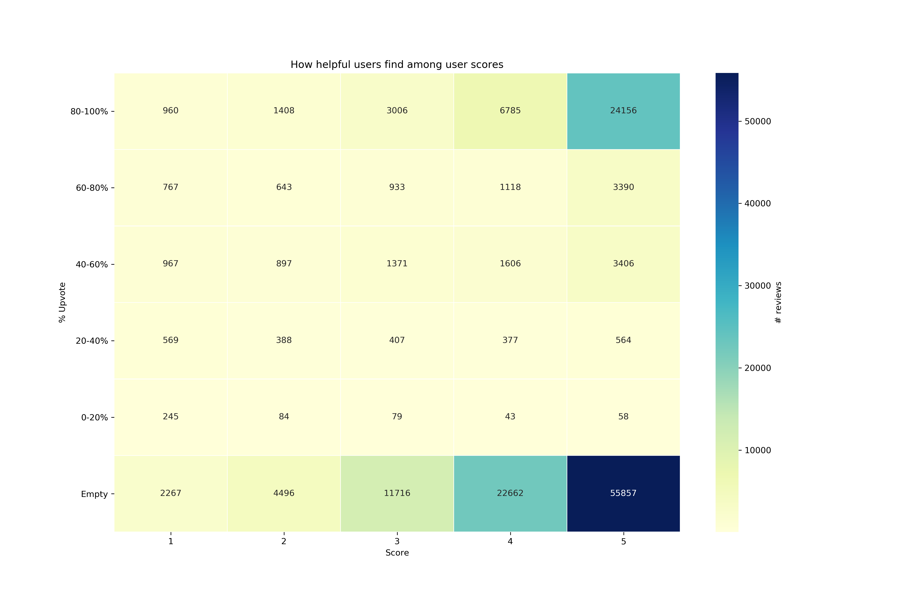
observing (% upvote) vs Score vs reviews
(+ve) reviews are polarized towards both empty & 80-100% upvotes.
(-ve) reviews are polarized towards empty upvotes.
Reviews are skewed towards positive
Many people agree with score 5 reviews
Negative reviews
Positive reviews
Page 9

Slide 11
Trying different statistical models
Data Preparation
Word-cloud for positive and negative sentiments
Score prediction using best one
Method 1
Logistic regression model on TFIDF
Method 2
Logistic regression model on TFIDF + ngram
Method 3
Logistic regression model on word count
Page10

Slide 12
Trying different statistical models
Data Preparation
Word-cloud for positive and negative sentiments
Score prediction using best one
Logistic regression model on term frequency–inverse document frequency (TFIDF)
Method 1
TfidfVectorizer and excluding stopwords
Dividing Transformed text and sentiment type into training and testing dataset.
Applying logistic regression (Sentiment type vs Transformed text )
Check accuracy with testing dataset
Results
*Transformed features no: 72778
*Train records: 100285
*Test records: 33429
Model Prediction Accuracy: 93.6312782315 %
Top 10 positive words:
Coefficient Word
10.330538 great
9.172264 delicious
7.872033 nice
7.567186 good
7.197401 perfect
6.954591 best
6.032440 wonderful
5.898172 excellent
5.589050 tasty
5.562668 highly
Top 10 negative words:
Coefficient Word
-5.378031 tasteless
-5.580406 horrible
-5.643597 sorry
-5.752467 disappointment
-5.958668 unfortunately
-5.977766 terrible
-6.271611 disappointing
-6.357921 awful
-6.905244 bland
-7.056081 worst
Page 11

Slide 13
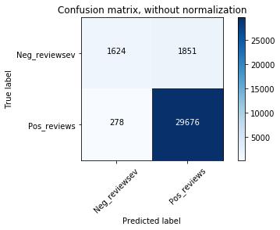
Trying different statistical models
Data Preparation
Word-cloud for positive and negative sentiments
Score prediction using best one
Logistic regression model on term frequency–inverse document frequency (TFIDF)
 | precision | recall | f1-score | support
0 | 0.85 | 0.47 | 0.60 | 3475
1 | 0.94 | 0.99 | 0.97 | 29957
Avg/ total | 0.93 | 0.94 | 0.93 | 33429
Prediction Accuracy= 94.319219%
Page 12

Slide 14
Trying different statistical models
Data Preparation
Word-cloud for positive and negative sentiments
Score prediction using best one
Logistic regression model on TFIDF + ngram
Method 2
Adding ngram parameter to TfidfVectorizer and excluding stopwords
Dividing Transformed text and sentiment type into training and testing dataset.
Applying logistic regression (Sentiment type vs Transformed text )
Check accuracy with testing dataset
Results
*Transformed features no: 2027861
*Train records: 100285
*Test records: 33429
Model Accuracy: 92.596248766 %
Top 10 positive words:
Coefficient Word
13.601722 great
10.243834 delicious
9.981401 good
9.465035 nice
8.293154 best
7.846822 perfect
6.843529 tasty
6.573463 love
6.399974 wonderful
6.348155 favorite
Top 10 negative words:
Coefficient Word
-6.191474 sorry
-6.209179 disappointing
-6.275983 taste
-6.786589 horrible
-7.032662 unfortunately
-7.082612 terrible
-7.500763 worst
-7.506268 disappointed
-7.726730 awful
-8.727231 bland
Page 13

Slide 15
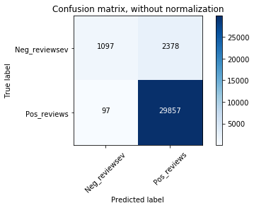
Trying different statistical models
Data Preparation
Word-cloud for positive and negative sentiments
Score prediction using best one
Logistic regression model on TFIDF + ngram
 | precision | recall | f1-score | support
0 | 0.92 | 0.32 | 0.47 | 3475
1 | 0.93 | 1.00 | 0.96 | 29957
Avg/ total | 0.93 | 0.93 | 0.91 | 33429
Prediction Accuracy = 93.830115%
Page 14

Slide 16
Trying different statistical models
Data Preparation
Word-cloud for positive and negative sentiments
Score prediction using best one
Logistic regression model on word count
Method 3
Text transformation excluding stopwords
Dividing Transformed text and sentiment type into training and testing dataset.
Applying logistic regression (Sentiment type vs Transformed text )
Check accuracy with testing dataset
Results
*Transformed features no: 72778
*Train records: 100285
*Test records: 33429
Model Accuracy: 93.6641837925 %
Top 10 positive words:
Coefficient Word
2.503198 pleasantly
1.962487 complaint
1.863467 hooked
1.837257 skeptical
1.777257 guilty
1.743022 fabulous
1.722270 fantastic
1.705230 hesitate
1.663895 perfect
1.644759 affect
Top 10 negative words:
Coefficient Word
-2.039530 tasteless
-2.042786 skip
-2.057494 sad
-2.073111 weakest
-2.104068 yuck
-2.108728 sorry
-2.173604 mediocre
-2.378847 disappointing
-2.404094 disappointment
-2.531285 worst
Page 15

Slide 17

Trying different statistical models
Data Preparation
Word-cloud for positive and negative sentiments
Score prediction using best one
Logistic regression model on word count
 | precision | recall | f1-score | support
0 | 0.74 | 0.60 | 0.66 | 3475
1 | 0.95 | 0.98 | 0.97 | 29957
Avg/ total | 0.93 | 0.94 | 0.93 | 33429
Prediction Accuracy = 96.133539%
Page 16

Slide 18
Trying different statistical models
Data Preparation
Word-cloud for positive and negative sentiments
Score prediction using best one
Summary Results
From Three methods
 | Word count | TFIDF | TFIDF+ ngram
No of features | 72778 | 72778 | 2027861
Model Accuracy | 93.6642% | 93.6313% | 92.5962%
True Negative | 2068 | 1624 | 1096
True Positive | 29243 | 29676 | 29857
False Negative | 1407 | 1851 | 2379
False Positive | 711 | 278 | 97
Recall | 0.94 | 0.99 | 1.00
Precision | 0.98 | 0.94 | 0.93
Prediction Accuracy | 96.133539% | 94.319219% | 93.830115%
F1 score | 0.97 | 0.97 | 0.96
Equations:
*Accuracy = TP+TN
TP+FP+FN+TN
*Precision = TP
TP+FP
*Recall = TP
TP+FN
*F1 Score =
2*(Recall * Precision)
(Recall + Precision)
Page 17

Slide 19
Trying different statistical models
Data Preparation
Word-cloud for positive and negative sentiments
Score prediction using best one
Summary Results
From Three methods
 | Word count | TFIDF | TFIDF+ ngram
No of features | 72778 | 72778 | 2027861
Model Accuracy | 93.6642% | 93.6313% | 92.5962%
True Negative | 2068 | 1624 | 1096
True Positive | 29243 | 29676 | 29857
False Negative | 1407 | 1851 | 2379
False Positive | 711 | 278 | 97
Recall | 0.94 | 0.99 | 1.00
Precision | 0.98 | 0.94 | 0.93
Prediction Accuracy | 96.133539% | 94.319219% | 93.830115%
F1 score | 0.97 | 0.97 | 0.96
Key Points:
*F1 scores are same for word-count and TFIDF
*Precision is best in word-count
*On the contrary, recall is lowest in word-count
*Prediction accuracy is highest in Word-count
*Word coefficients are high in TFIDF and TFIDF+ngram
So TFIDF can be the best prediction option
For grocery reviews
Page 18

Slide 20
Word-cloud for positive and negative sentiments
Trying different statistical models
Score prediction using best one
Data Preparation
Score 1
Score 2
- reviews
Text to vectors
Transformations on corpora and text stemming
Creating text document matrix
Create word-cloud
Score 4
Score 5
+ reviews
Page19

Slide 21
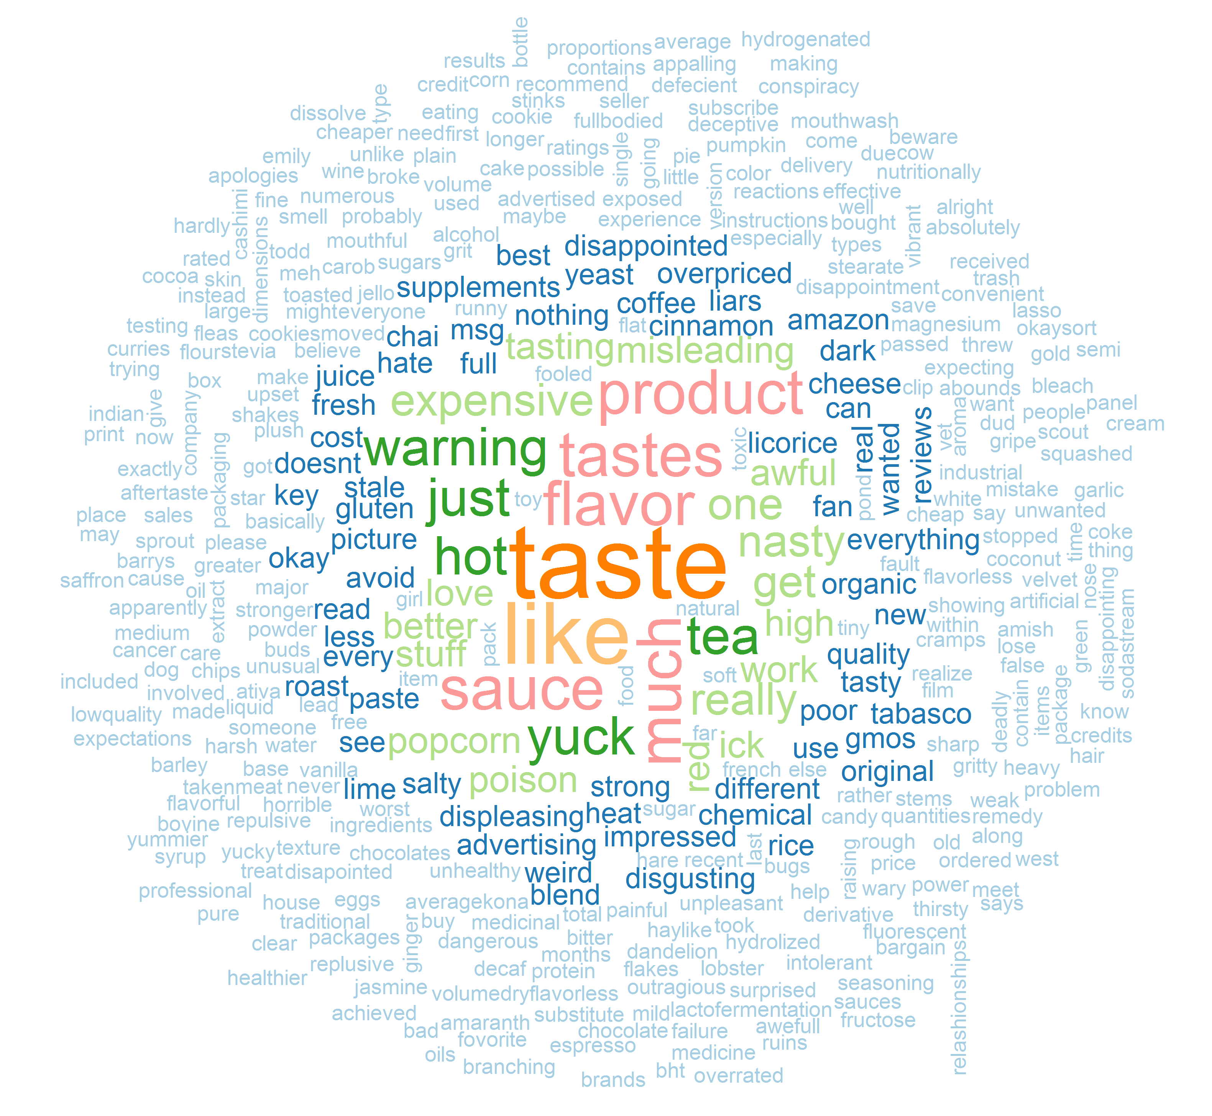
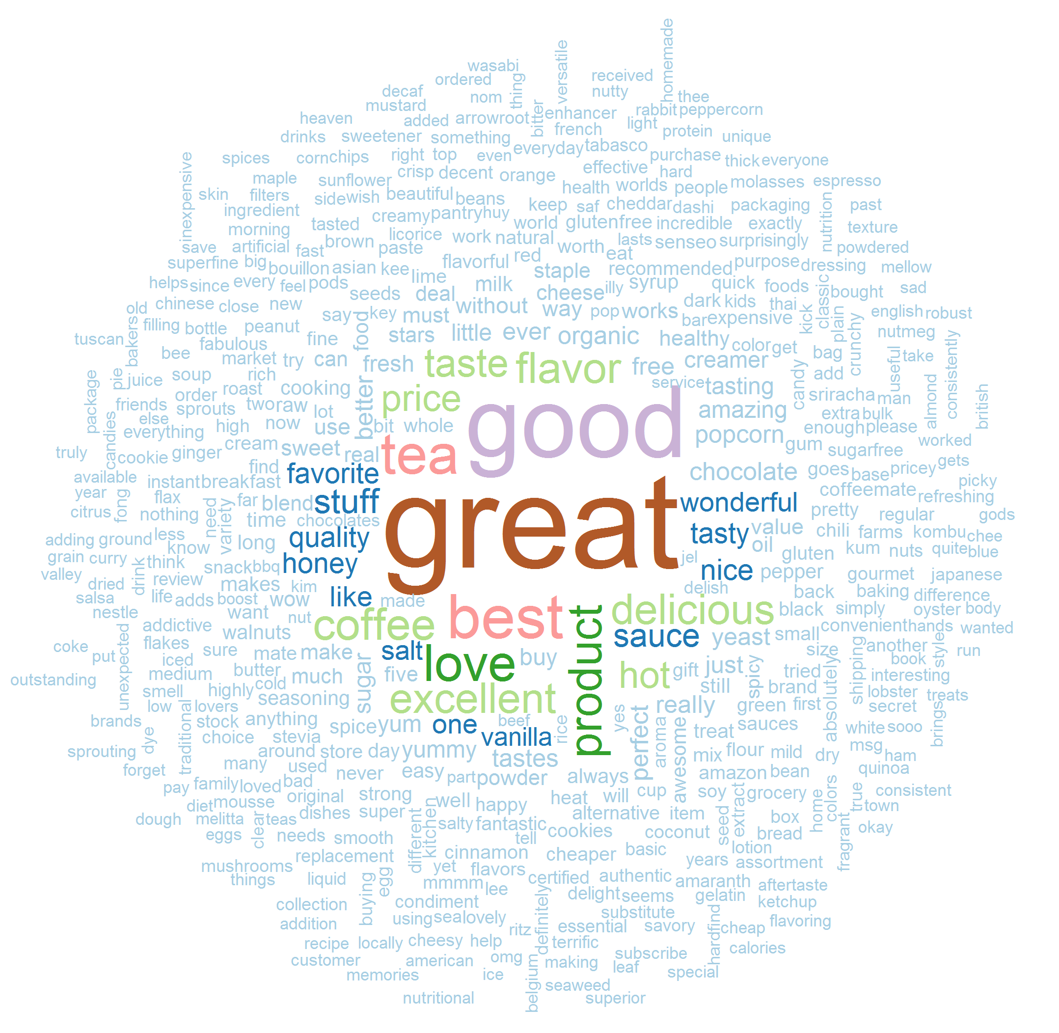
Word-cloud for positive and negative sentiments
Trying different statistical models
Score prediction using best one
Data Preparation
(-) Reviews
(+) Reviews
Page20

Slide 22
References & acknowledgement
Liu, B. (2012). Sentiment analysis and opinion mining. Synthesis lectures on human language technologies, 5(1), 1-167.
Data Source: http://jmcauley.ucsd.edu/data/amazon/links.html
Page 21

Slide 23


Slide 24

QUESTIONS

